Slide 1
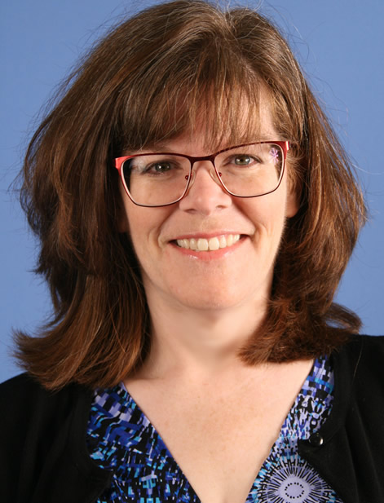
Ellen M. Phillips
Work
School
Interests
I feel that consumer health librarianship is an information specialty that exemplifies the needs of the quantified self in an era of due diligence.
Notes:
Hello my name is Ellen Phillips. I am looking forward to learning about Consumer Health Librarianship with you. I’d like to tell you a little bit about myself.

Slide 2
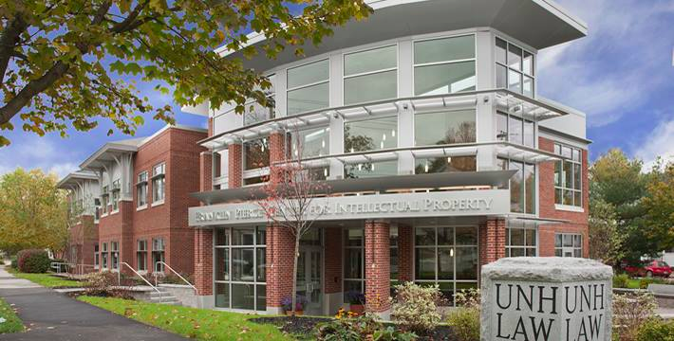
Work
I am the Serials Supervisor at the University of New Hampshire School of Law in Concord, NH.
Journals, periodicals, continuations
Anything received on a regular basis.
Catalog donations of monographs
Preservation wrapping/repair
Oversee bindery process
Notes:
I work at a small law school that is part of the New Hampshire state university system located in Concord, NH. We are a government documents repository and are particularly well-known for our intellectual property law programs. I am responsible for the print serials collection. When you subscribe to hundreds of publications, overseeing the receipt of them all becomes quite a job. As you can see I do a few other things there as well. I am fortunate in that work is very supportive of my efforts and the librarians that I work with are great about sharing what they know with me.

Slide 3
Work
New Health Law and Policy Program
Hosting Law Librarians of New England Spring Conference
Bridge over Troubled Water: Mindfulness and Librarians
Notes:
One of the reasons I am looking forward to this class is due to the New Health Law and Policy program that we have at UNH. We also have a Sports Law Institute.
Our library was also asked to host the Law Librarians of New England Spring Conference. We chose the theme of Mindfulness and the Law. I am really enjoying learning about this topic and will be writing about this in my blog.
I am on the publicity committee, creating the online brochure.

Slide 4
School
SJSU Fall 2013
One more core class to go (Information Professions).
This semester taking Online Searching, Consumer Health Librarianship and Music Librarianship
Member of SLA, ASIS&T and Phi Kappa Phi
Enjoy SJSU Podcasts in the car
Notes:
I started library school in the Fall of 2013. I am taking my time, going slowly due to work and family life.
I feel that you have to be a generalist, which is one of the reasons why I was interested in taking this class. I am also taking Online Searching and Music Librarianship. Working full time doesn’t leave me with a lot of time for activities by I am a member of a few organizations.

Slide 5
Professional Associations
New Hampshire Library Association/Reference and Adult Services Committee (NHLA/READS)
Created print brochure for Fall 2014 Conference
Created online Brochure for Spring 2015 Round Table Discussions
Completed Course in php myadmin.
Law Librarians of New England (LLNE)
Attended seminar on Legal research.
Notes:
I *am* active with a few professional associations, however. I seem to get asked to create a lot of brochures, which is fun for me. NHLA, my local state library association also offers classes. I took one in php myadmin and am looking for online databases that I can create. I also was invited to a seminar on legal research, which really helped me understand the items that I am working with. Law books are quite different from a lot of other types of research materials.

Slide 6
Interests & other info
ellenmetal.com
It’s been an interesting path getting to library school. I’ve made jewelry, restored antique dolls, worked for a symphony orchestra, marketed software and taught preschool. Along the way I married my college sweetheart and we have two beautiful children.
Notes:
I’ve done a lot of other jobs including running my own jewelry company which I started when I was studying English at Marist College. After graduation I studied at the Fashion Institute of Technology (FIT) in New York and there I learned how to solder, cast metal, draw wire and create all kinds of jewelry. I have a website at ellenmetal.com where you can see a slideshow of my work and read about how I make some of the pieces. I am an avid cyclist; as long as the roads are free of ice, I’ll consider riding. My husband and I recently celebrated our 21st wedding anniversary and although we spent more than a few years living like a couple of corporate gypsies, we have recently settled down in Southern New Hampshire with our two boys, Chris, who is 13 and Thomas aged 9.

